Slide 1

4
Vector geometry

Slide 2
Chapter Outline
4.1. Vectors and Lines
4.2. Projections and Planes
4.3. More on the Cross Product
4.4. Linear Operations on ○³
4.5. An application to Computer Graphics

Slide 3
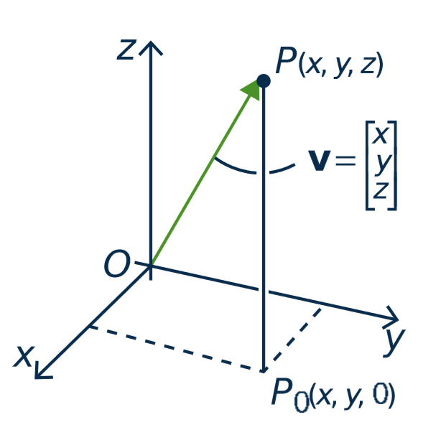
4.1. Vectors and Lines
point P(x, y, z)
Vectors in ○³
The terms vector and point
are interchangeable.
vector v

Slide 4
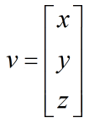

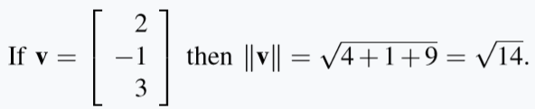
Vectors in ○³
Length.
If then
Ex.

Slide 5

True or false?
If $\left\|v\right\|$ = 3, then $\left\|−2v\right\|$ = -6.
If $\left\|v\right\|$ = 0, then $v$ is zero vector.
-2v
v

Slide 6
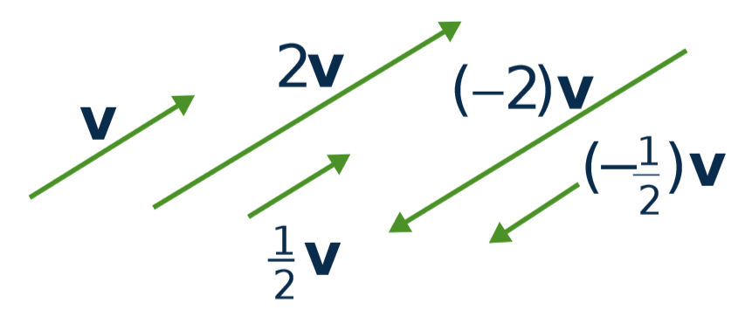
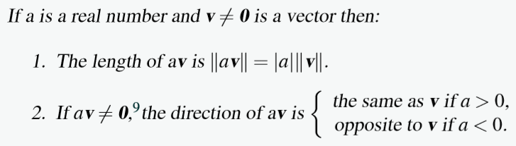
Scalar Multiple Law

Slide 7
Equality
Let v ≠ 0 and w ≠ 0 be vectors in R³.
Then v = w if and only if v and w have the same direction and the same length.
➔ The same geometric vector can be positioned anywhere in space.
•
•
v
w
•
•

Slide 8
Parallel vectors
Two nonzero vectors are called parallel if they have the same or opposite direction.
v and w are parallel ⇔ v = kw for some scalar k
v
-2v

Slide 9
The Parallelogram Law
v
v + w ⬅ first v then w
w
v + w = w + v

Slide 10
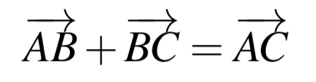
Tip-to-tail rule
B
C
A

Slide 11
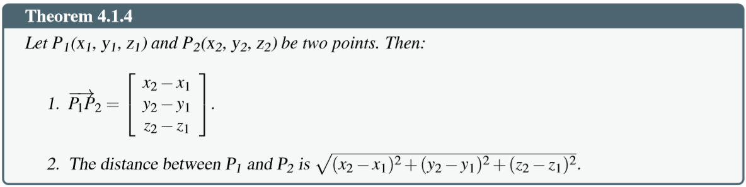
Distance between two points

Slide 12
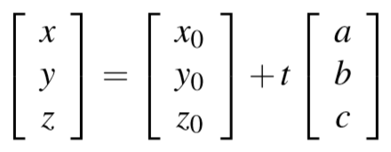
Lines in Space
Given the point P₀ (with vector p₀) and the direction vector d ≠ 0.
Then line parallel to d through the point P₀ is given by:
p = p₀ + td,
(t is any number)

Slide 13
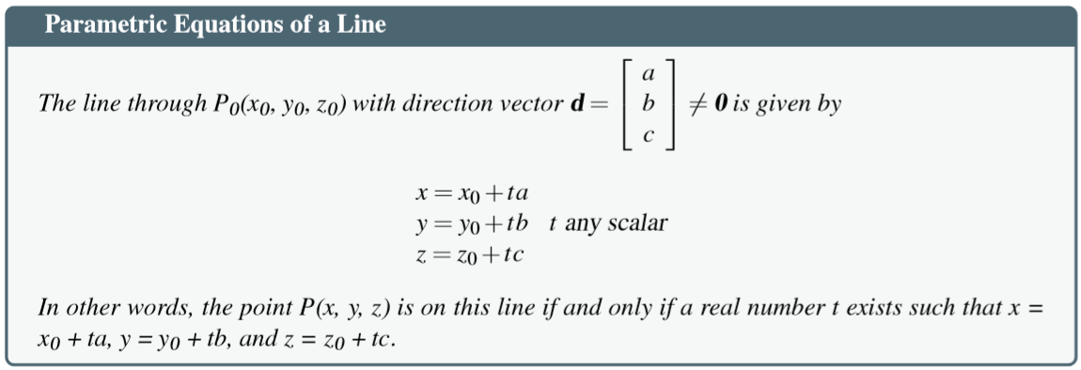
Lines in Space

Slide 14
Lines in Space
Ex. Given P₀()

Slide 15
Lines in Space
Ex. Given P₀()

Slide 16
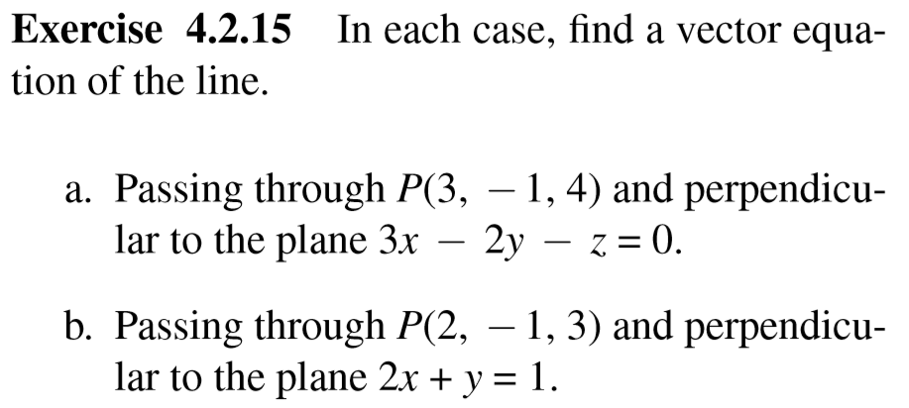

Slide 17
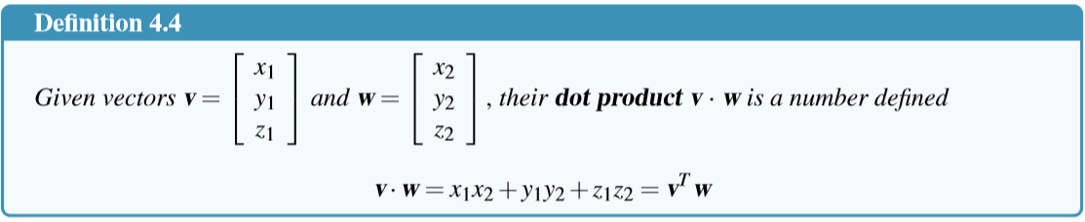
4.2 Projections and Planes
The Dot Product

Slide 18
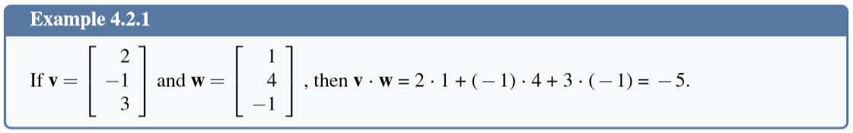
The Dot Product

Slide 19
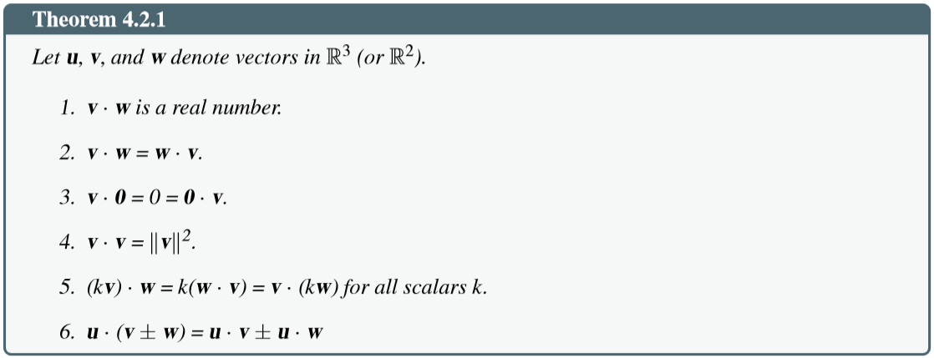
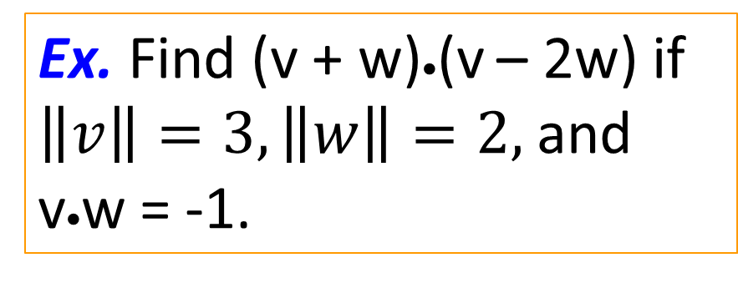
Properties of dot product
Ex. Find (v + w)•(v – 2w) if $\left\|v\right\|=3, \left\|w\right\|=2,$and v•w = -1.

Slide 20
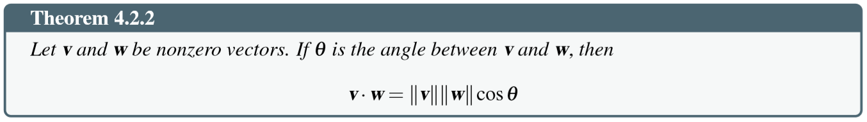
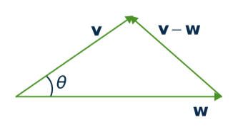
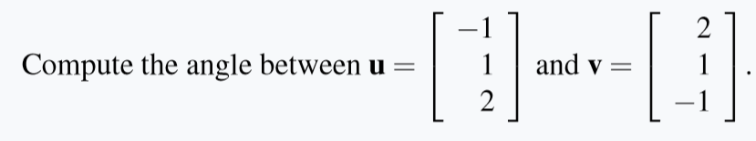
Angles between vectors
Example.

Slide 21
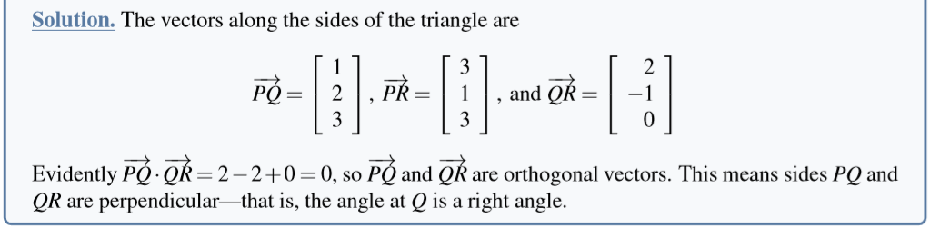
Orthogonality
Two vectors v and w are said to be orthogonal if
v • w = 0

Slide 22
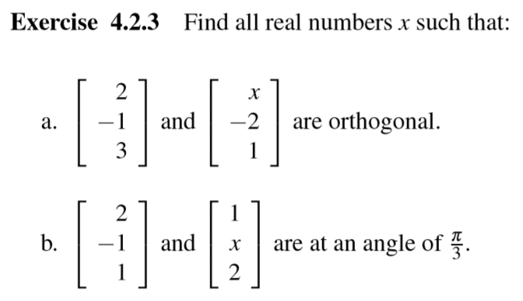

Slide 23
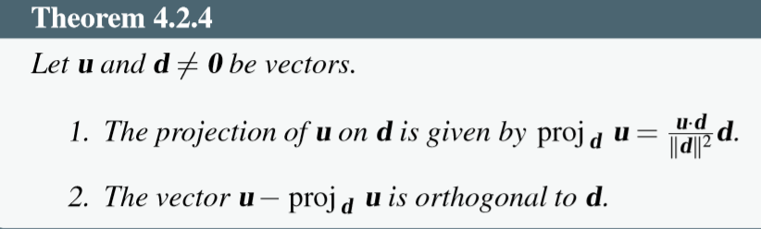
Projection
u
u – v
1. v ⁄ d
2. u – v ⊥ d
•
d
v

Slide 24
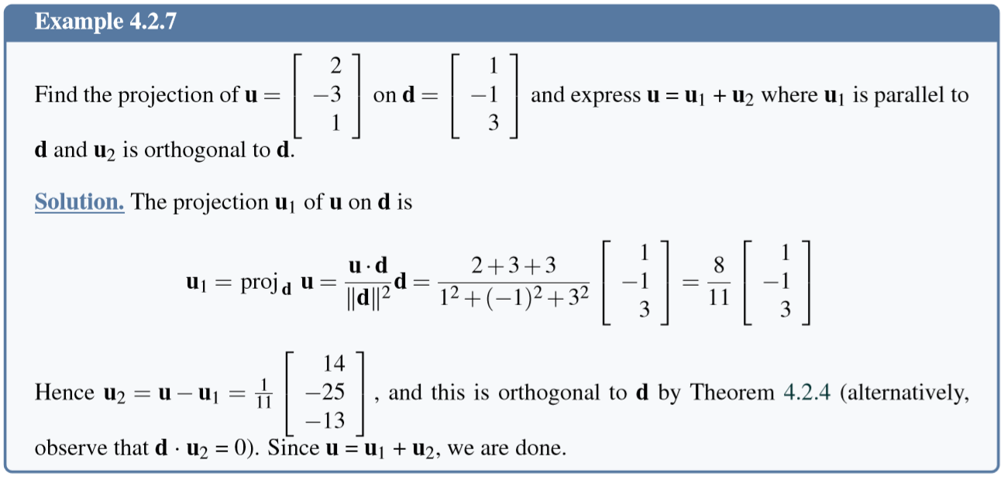
Projection

Slide 25
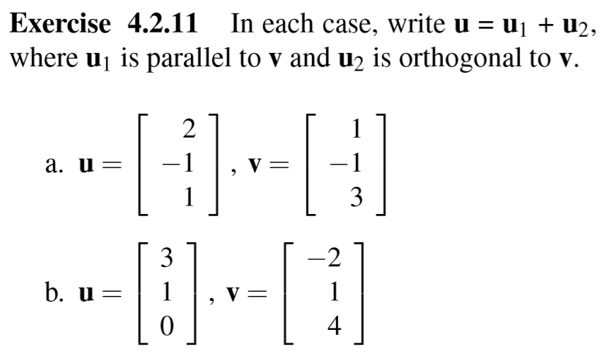

Slide 26
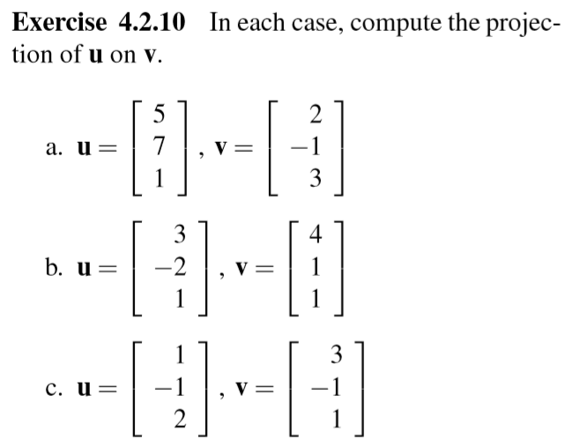

Slide 27
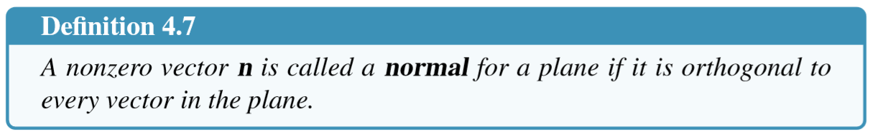
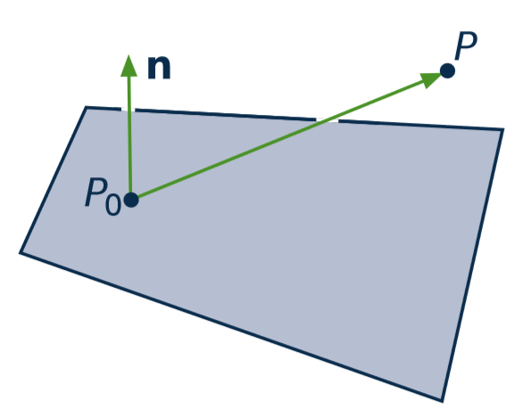


Planes

Slide 28
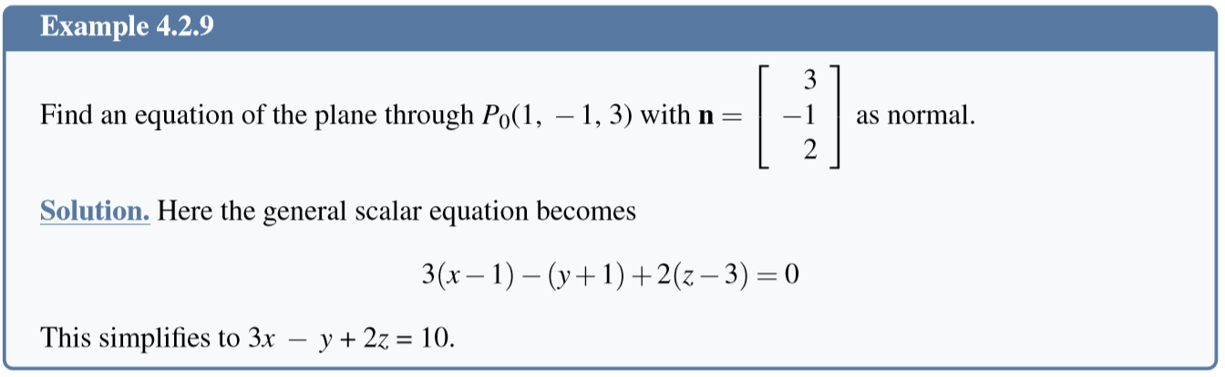
Equation of a Plane

Slide 29
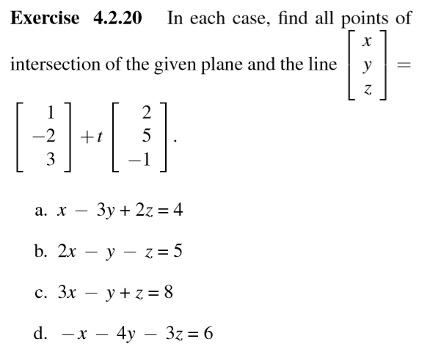

Slide 30
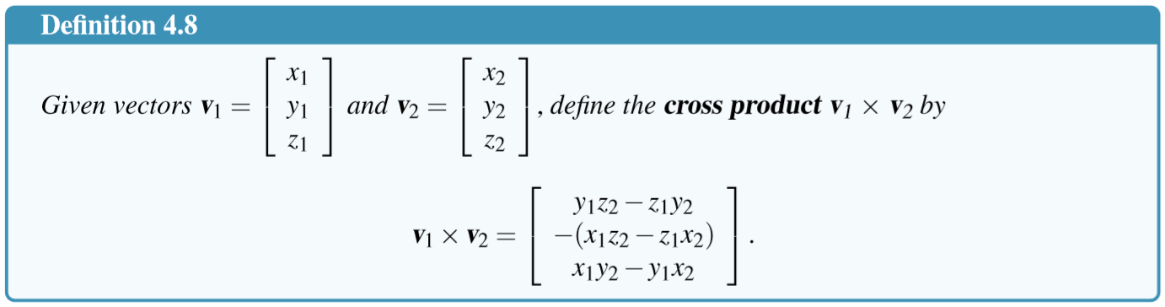
The Cross Product

Slide 31
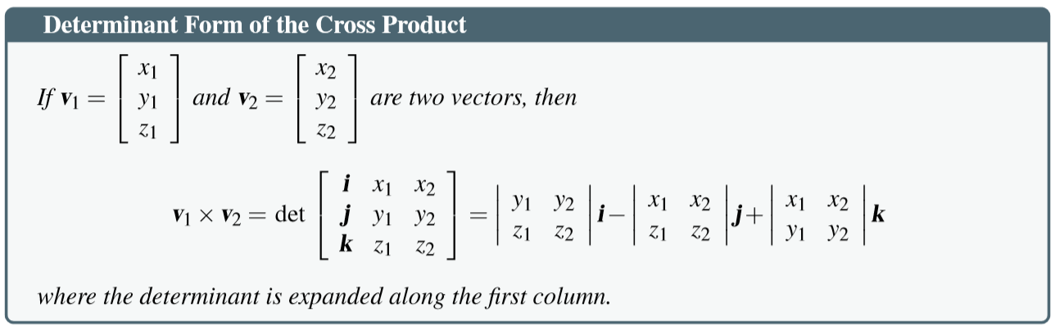

Slide 32
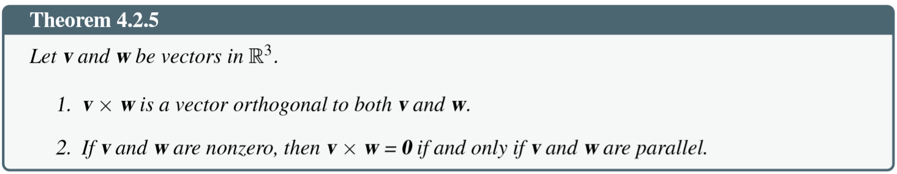
Properties of cross product

Slide 33
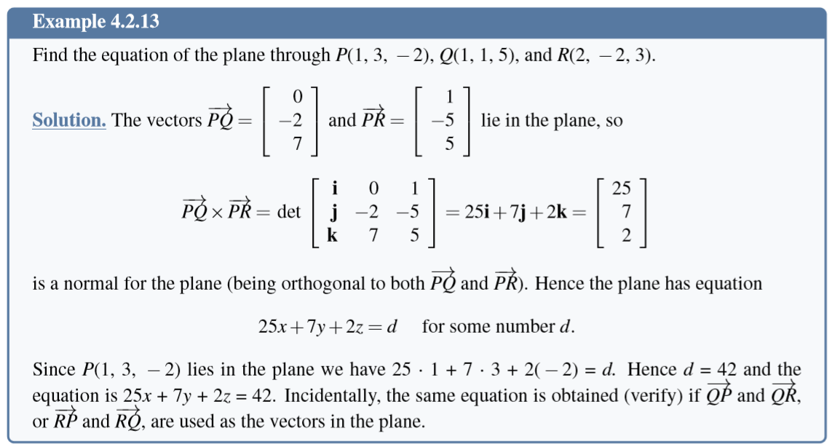

Slide 34
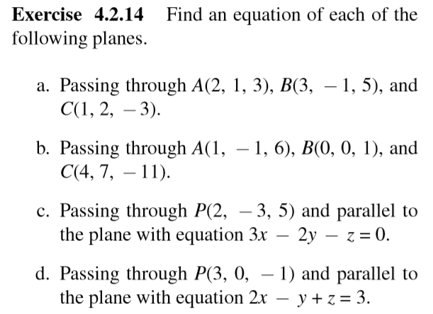
Exercises – equations of planes

Slide 35
4.3 More on Cross Product
Read yourself pages

Slide 36
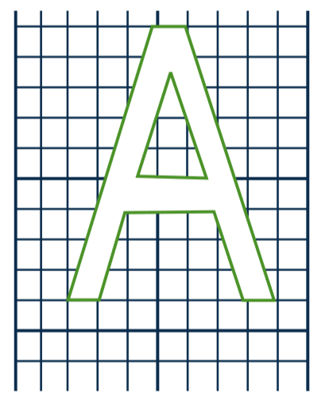
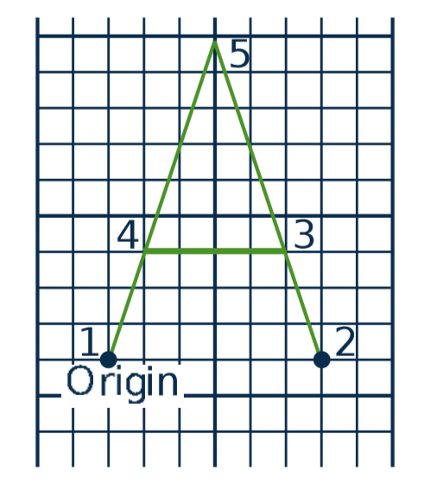
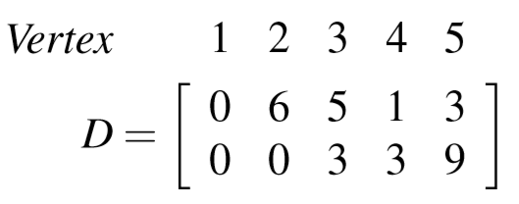
4.5 An application in Computer Graphics
Data matrix D

Slide 37
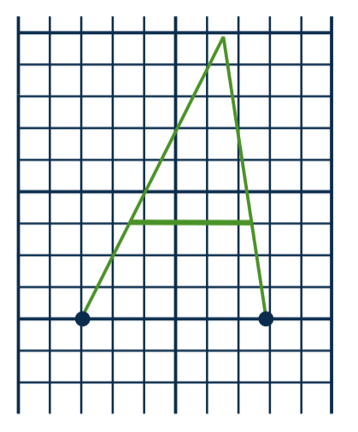
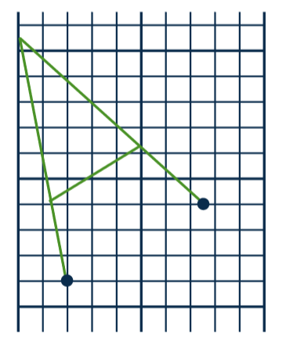
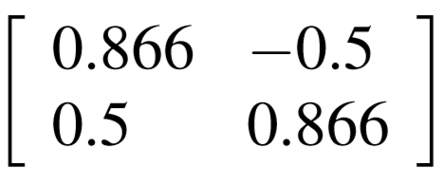
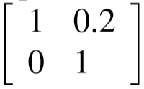
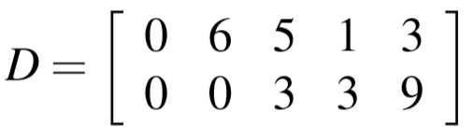


How to change image?
C
D
C

Slide 38
Computer graphics
Image ➔ matrix D
Matrices of transformations A₁, A₂, ..., A_{n}
Compute A_{n}...A₃A₂A₁D
3rd transformation
1st transformation
Data matrix
n^{th} transformation
2nd transformation

Slide 39
Some common transformations and their matrices
Reﬂections and Projections
Rotations
Translations

Slide 40
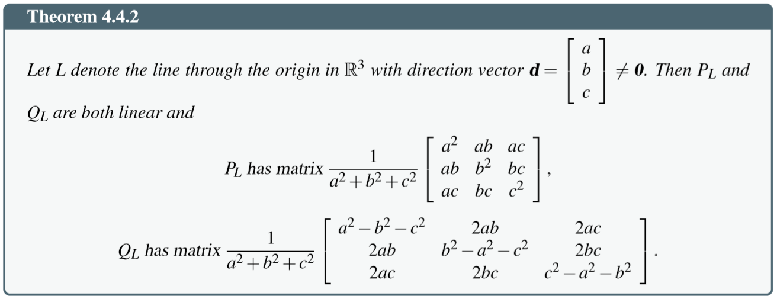
Matrices of Reﬂections and Projections
Reﬂections and Projections

Slide 41
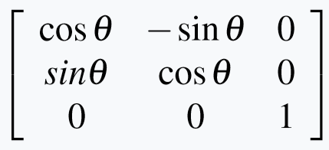
Matrices of Rotations

Slide 42
Matrices of Translations
Need a clever way to give these matrices (Read yourself in the text book)

Slide 43
Summary
4.1. Vectors and Lines
4.2. Projections and Planes
4.3. More on the Cross Product
4.4. Linear Operations on ○³
4.5. An application to Computer Graphics

